Slide 1
AWS SERVER STATUS
AWS performs automated checks on every running EC2 instance to identify hardware and software issues.
We can view the results of these status checks to identify specific and detectable problems. The event status data augments the information that Amazon EC2 already provides about the state of each instance (such as pending, running, Terminated).
For checking this we need to connect to AWS console.

Slide 2
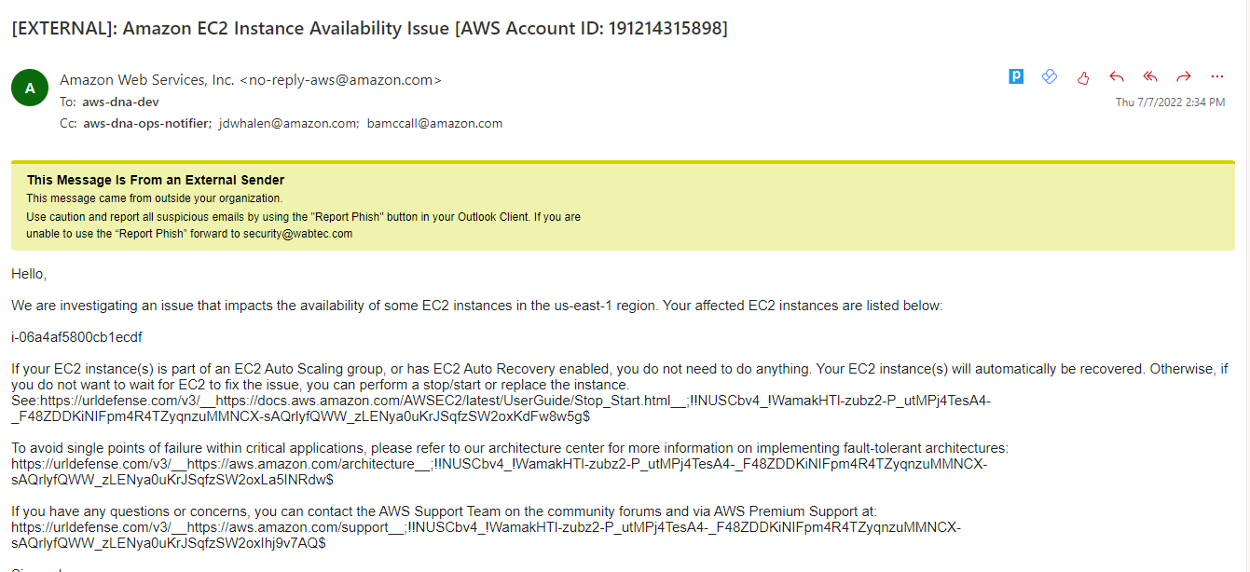
If any issue related to AWS Instance we will get mail like this.

Slide 3
Steps:
Open AWS Console.
Click on EC2 Instances.
Select Instances
Here we can see the list of Instances with Name, Instances ID, Instances state, Instances type, Status Check, Alarm state and Availablity Zone.

Slide 4
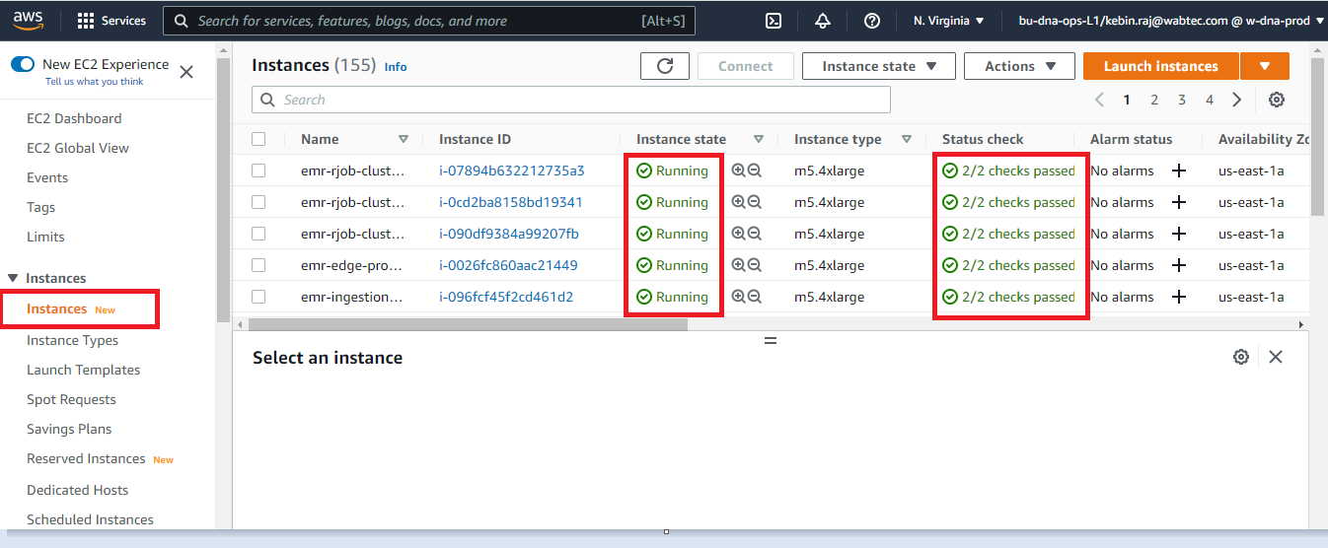
We need to login to the AWS console and check the status of Instance.

Slide 5
Conclusion:
We Monitor the instances state such as Pending, Running and Terminated.
If the instances is running, We can see the status 2/2 check passed.
Thank you.

